Slide 1
PCB Defect detection
Overview

Slide 2

AIM
To compare the Power Circuit Board and detect the errors in manufacturing the board

Slide 3

Tools Used
A Good amount of dataset in .json and COCO format
Adobe LightRoom
VGG Image Annotator (VIA)
Python using Anaconda
Visual C++ Build Tools
CUDA and CUDNN for NVIDIA
Protoc
Tensorflow Object Detection API

Slide 4

Methodology
1
Dataset Preparation and Annotation
Create a comprehensive dataset of PCB images and annotate the different defect types to train the RCNN model effectively.
2
Training the CNN Model
Train the CNN model using the annotated dataset to develop a highly accurate and efficient defect detection system.

Slide 5
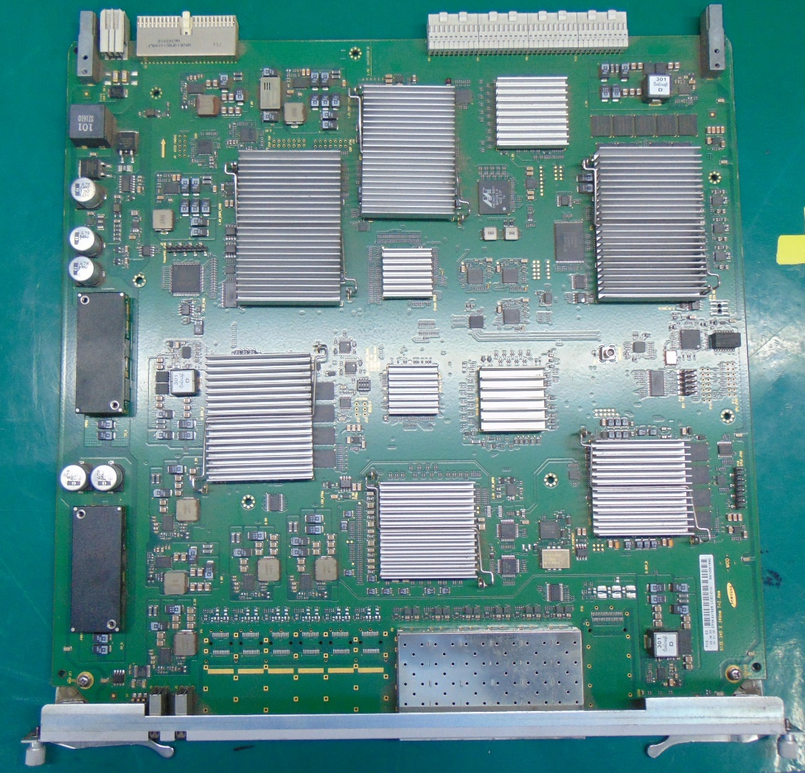
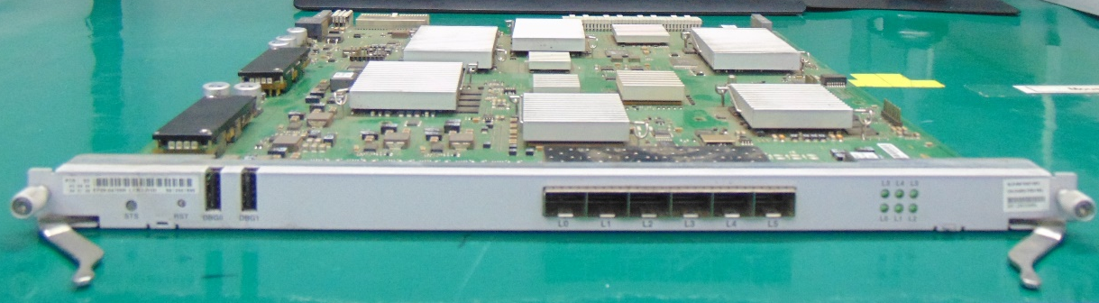
List of defects
Components missing
Component damages like chip-off, Broken, De-formation
Water damages/Corrosions
Connector pin damages/bent
Heatsink placement and count
Mechanical parts missing/damages
Labels missing/Damages

Slide 6
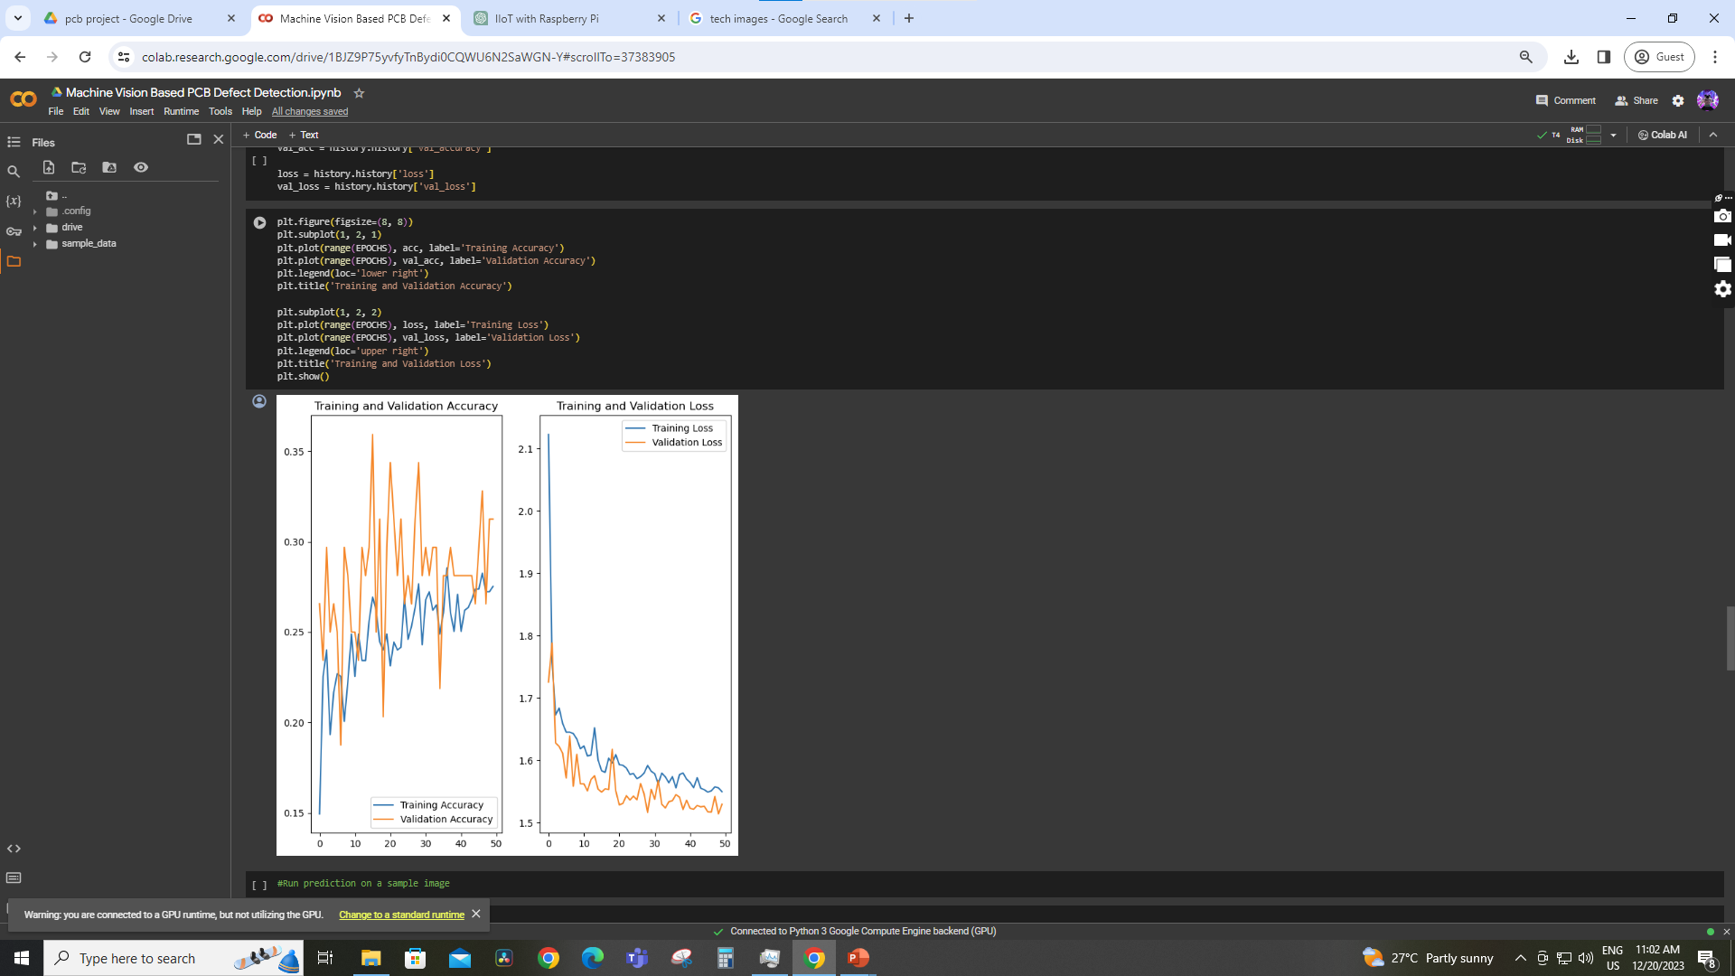
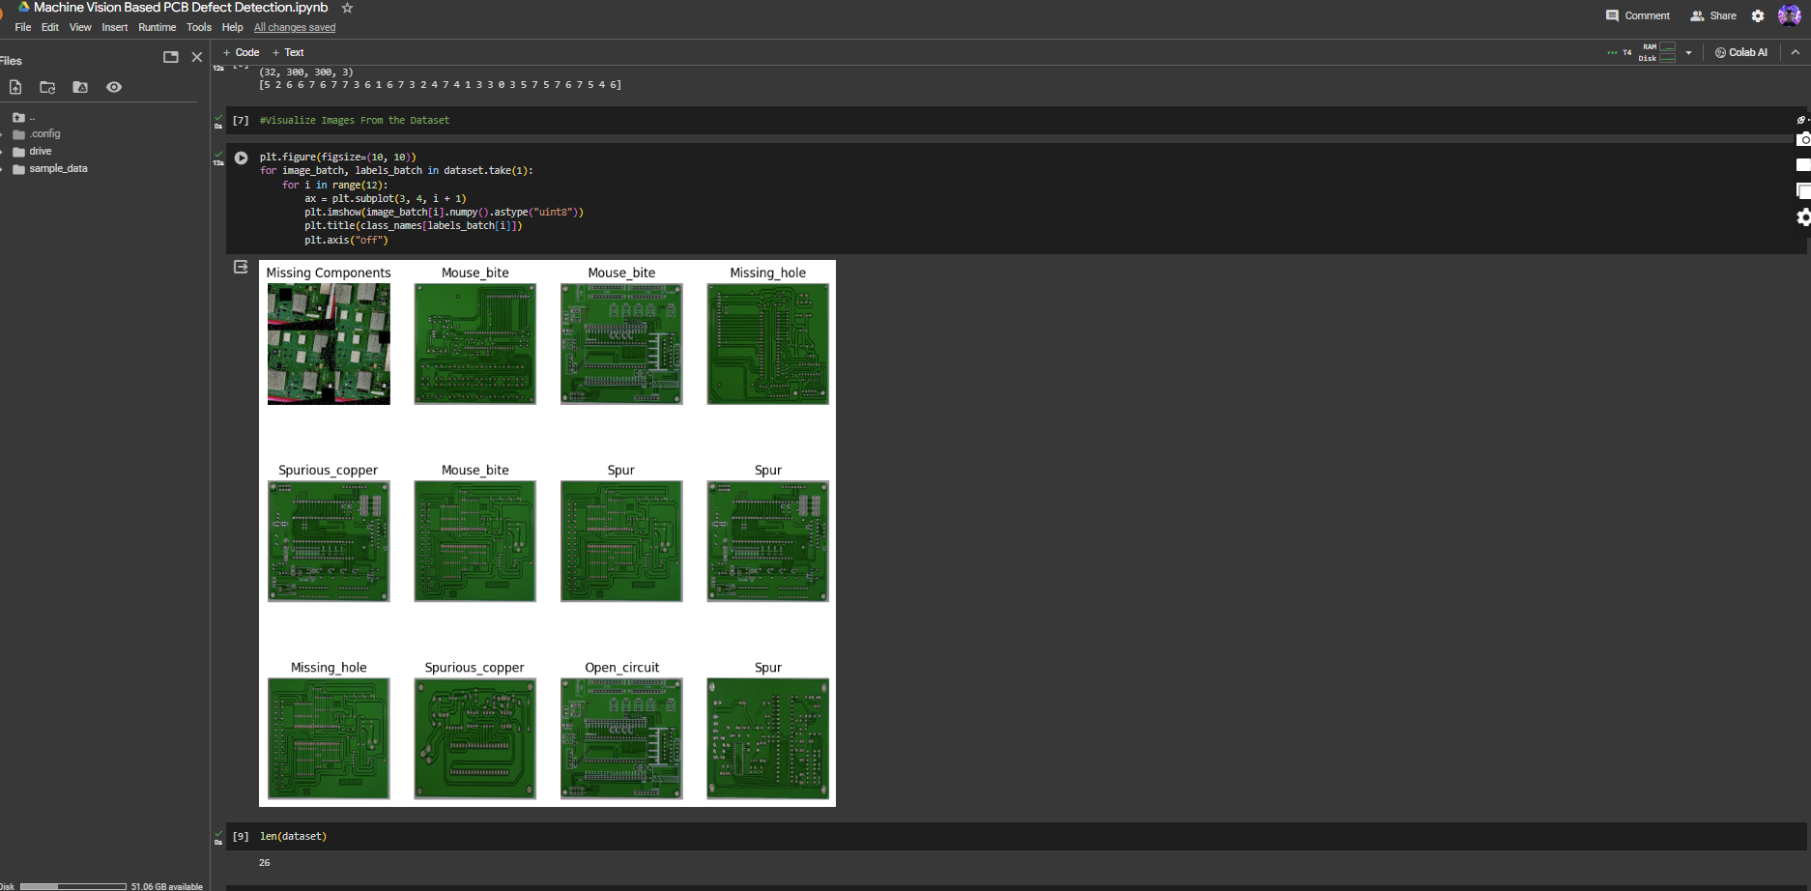
Source code

Slide 7
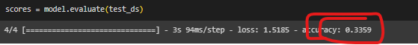
Recent Problem facing
Accuracy of the model trained is minimal and it should be above 75%

Slide 8
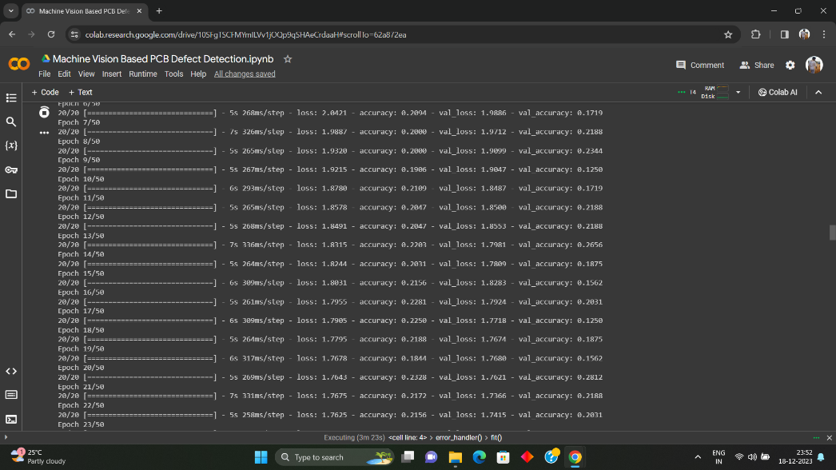
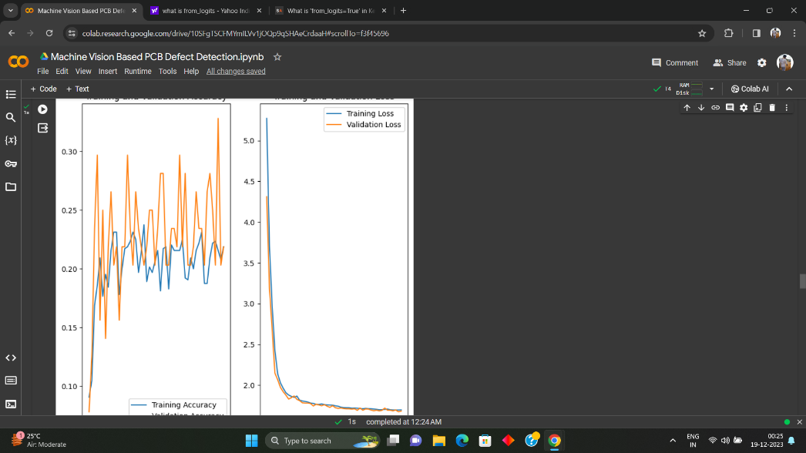
AFTER APPLYING L2 REGULARISATION
ACCURACY
LOSS AND ACCURACY GRAPH

Slide 9
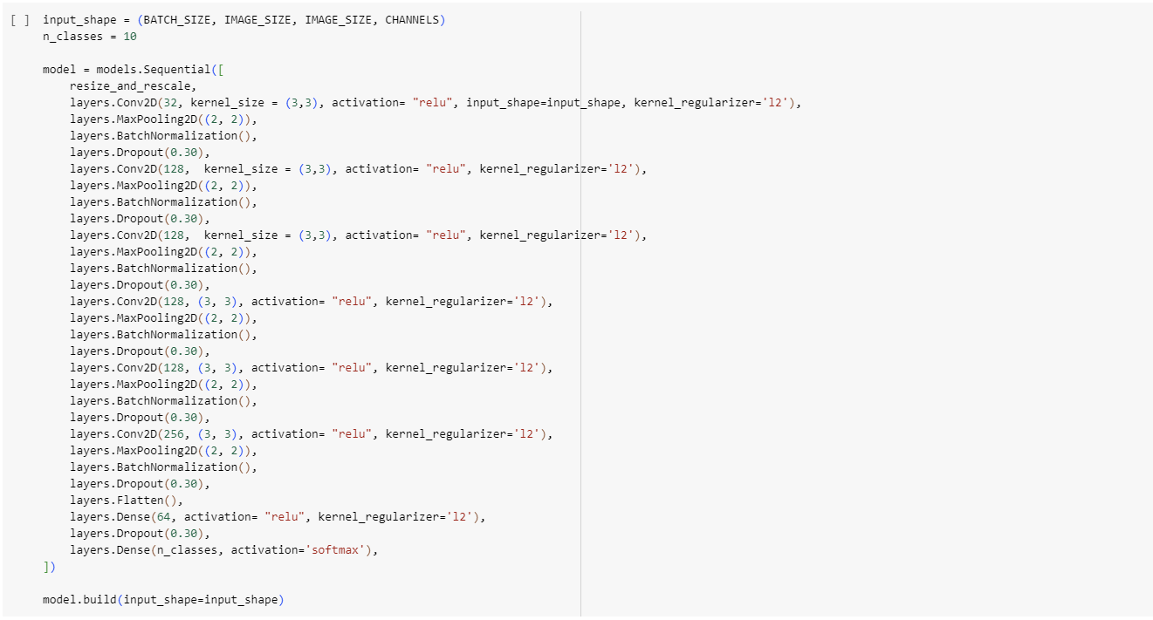

AFTER ADDING DROPOUT LAYERS
ACCCURACY

Slide 10
Approach to solve the problem
Learning Rate: Experiment with different learning rates. we can try reducing the learning rate to allow the model to converge more slowly and possibly reach a better minimum.
Regularization: Introduce dropout or other regularization techniques to prevent overfitting. Overfitting can be a reason for low validation accuracy.
Increase Data Size: If possible, increase the size of our dataset. More diverse data often helps the model generalize better. reason for low validation accuracy.
Hyperparameter Tuning: Experiment with different hyperparameter values, such as the number of layers, the number of neurons, and activation functions.

Slide 11

Trello updates

Slide 12
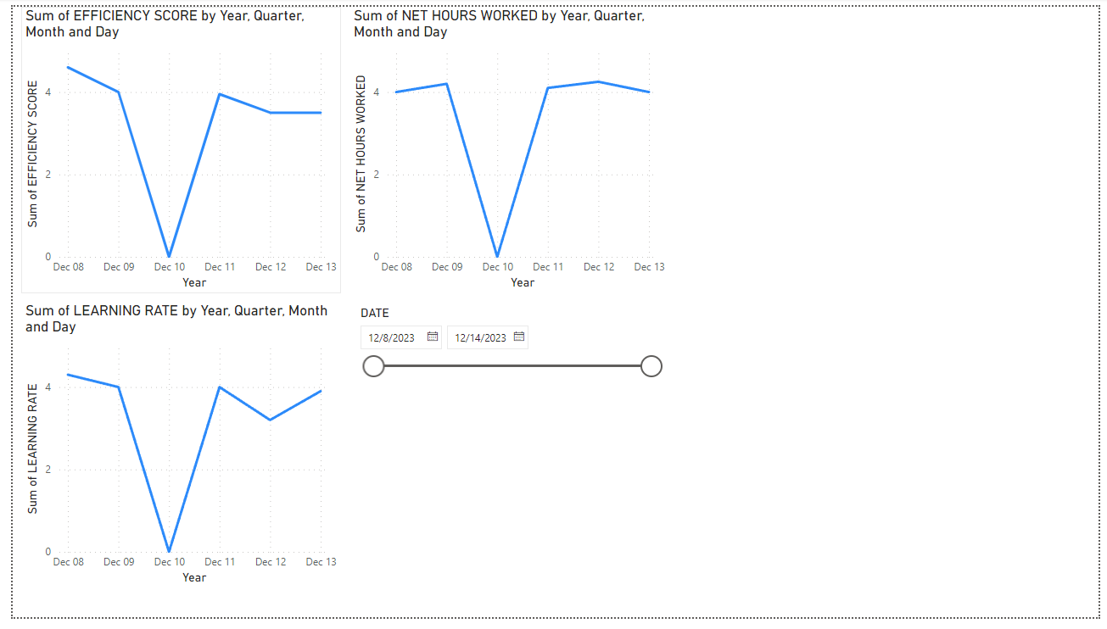
Power bi updates

Slide 13
THANK YOU

